Slide 1
Final Project
ASU CST 250
Jason Pototsky
11/24/2015

Slide 2
Bubble Sort
The first step to this project was understanding what a bubble sort was
Bubble sort is a linear sort algorithm that works on n, n+1 and determines if they need to be swapped
As the algorithm reaches the end of the array, n+x, that value is assumed to be at its final place. Meaning that the new method only moves to n+(x-1) as the final point on the next pass
This is one of the most simple methods of sorting an array

Slide 3
N
4
2
1
3
In this example, the process would continue until n+9 however the array is sorted at n+4.
N+1
2
4
1
3
N+2
2
1
4
3
N+3
2
1
3
4
N+4
1
2
3
4

Slide 4
Pseudocode
The basic structure of the code will consist of two loops, an outer loop and an inner loop.
The outer loop will control the amount of iterations as well as “fix” the final numbers in place by reducing the iterations each time.
The inner loop will conduct the checks to determine if the numbers n > n+1 and will switch as needed

Slide 5
func bubblesort( var a as array )
for i from 1 to N
for j from 0 to N - 1
if a[j] > a[j + 1]
swap( a[j], a[j + 1] )
end func

Slide 6
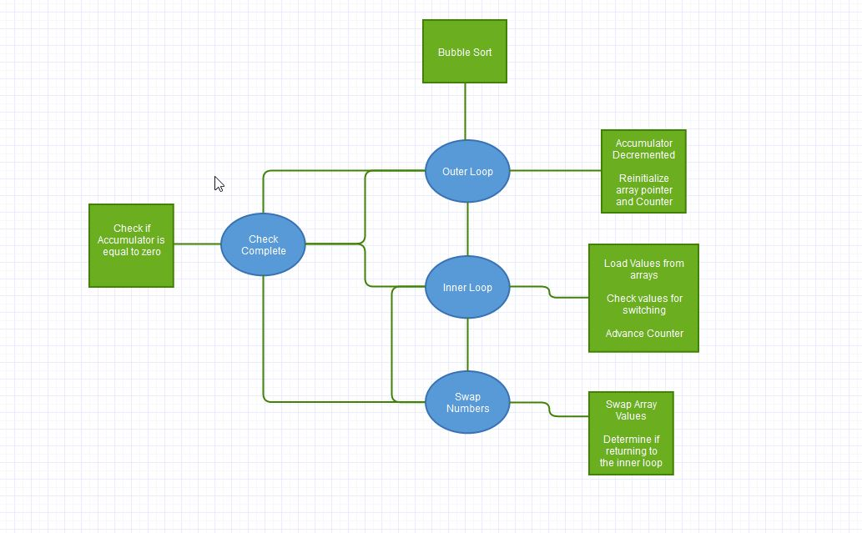

Slide 7
Optimization
Look for reusable sections of code and modularize the code
Look for reusable registers to reduce the amount of initializations that are needed
Look for logic that is redundant and can be eliminated
Look for opportunities for using Branch Delay slots to store variables
Look for areas to use immediate values instead of registers

Slide 8
Testing
Testing after every change is absolutely imperative
When changes are made to the code make sure to test in order to determine if the actions of the program remain the same
Set cycles to 1 and advance each section while having the watcher window up with all used registers to visualize what is being accomplished with the program
Testing can be an opportunity for identifying areas for optimization

Slide 9
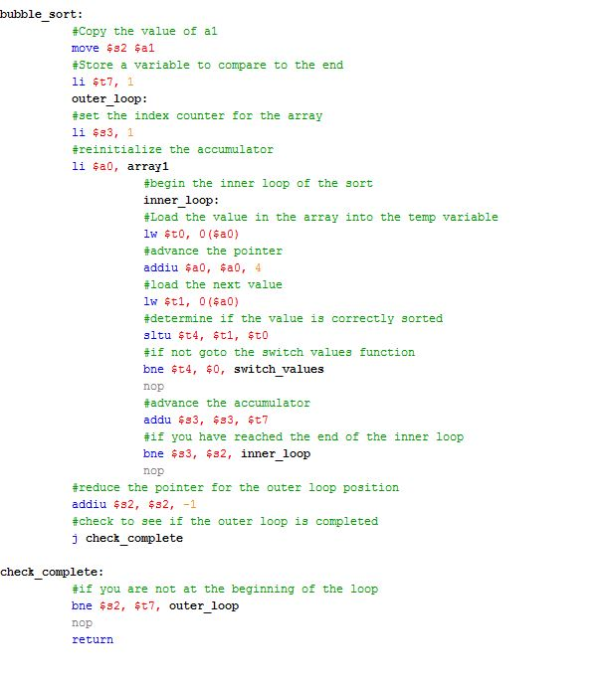
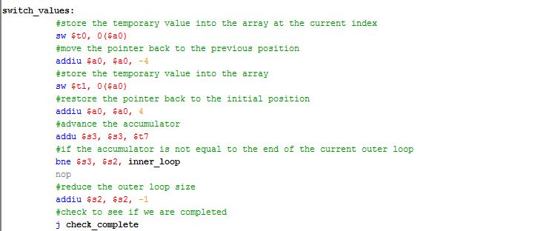

Slide 10
Summary
Design
Initial Design
Redesign based on optimization
Bug Fixing
Optimization
Eliminate redundancy
Testing
Constant at all steps

